Slide 1
Jason’s Trail new Boardwalk
13 January 2017

Slide 2
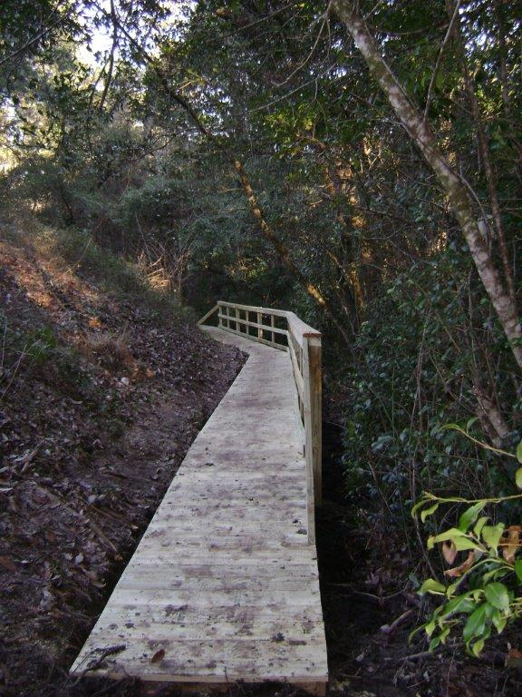
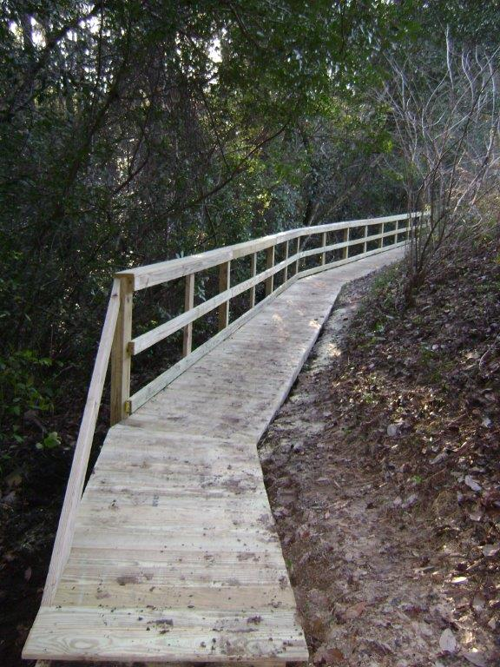
Looking East Looking West

